Slide 1
Assignment E2 - Zonal mean of precipitation
Eduardo Jimenez Hernandez, BE PhD student
ATMO555 Introduction to Atmospheric and Hydrologic Remote Sensing
University of Arizona
September 2, 2021

Slide 2
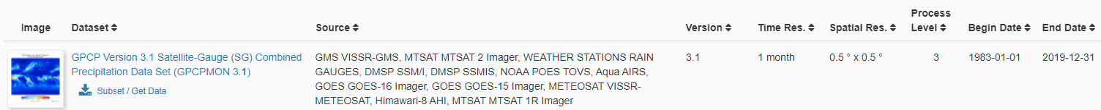
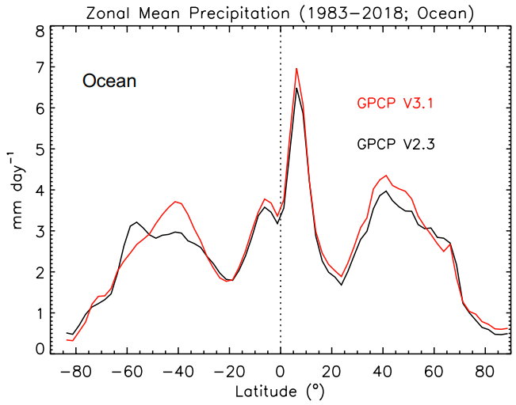
Selecting the data
From GES DISC download GPCP Version 3.1
Expected plot (shown at right)

Slide 3
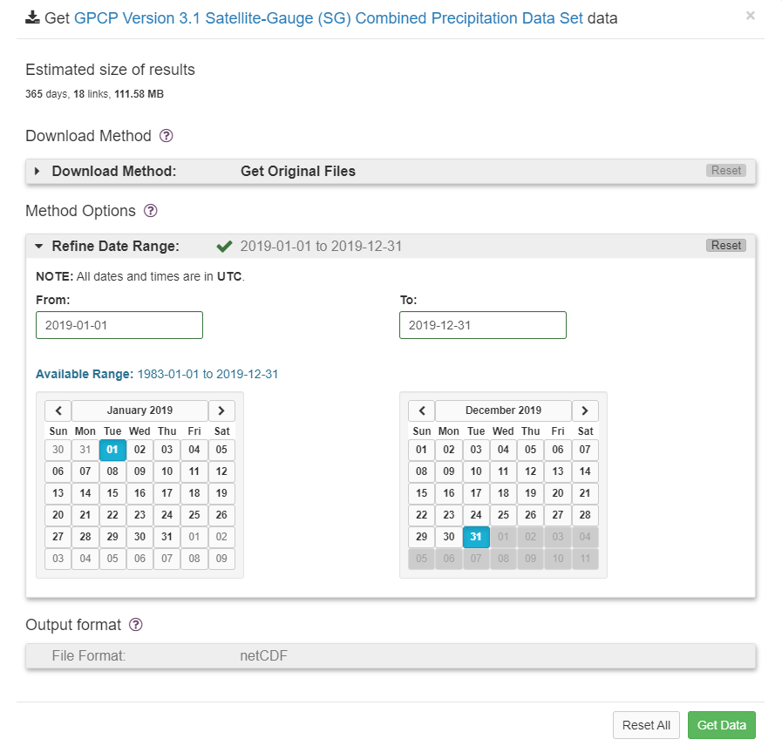
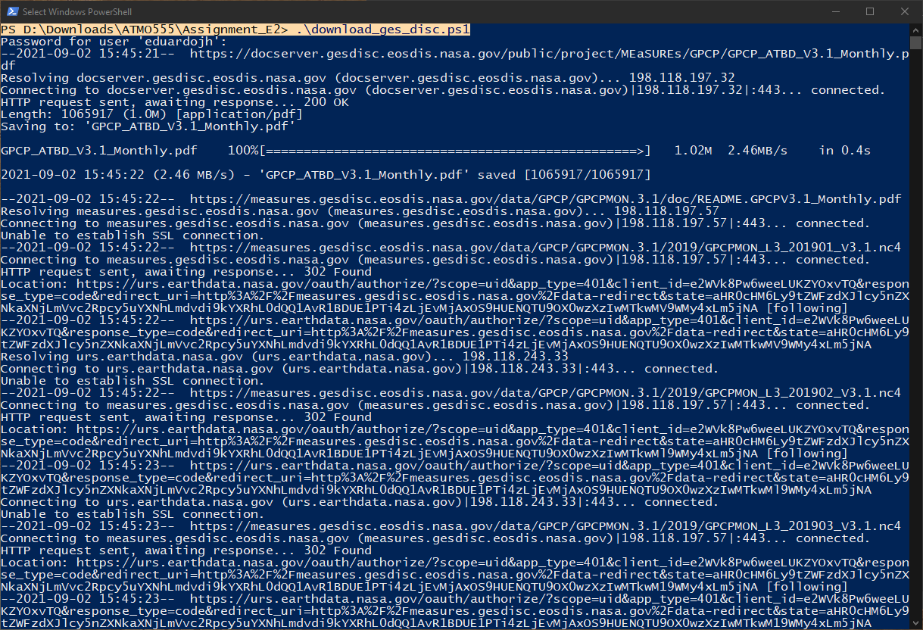
Download data for 2019 (Apr-Dec)
*Due to download errors only April-December files for 2019 were processed.

Slide 4
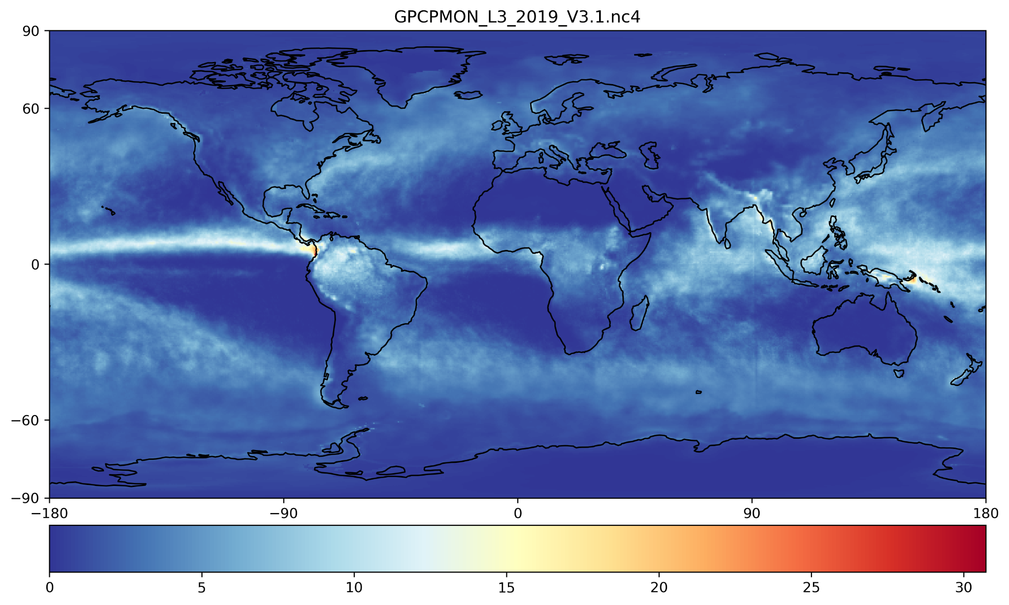
Plot of the mean values for precipitation

Slide 5
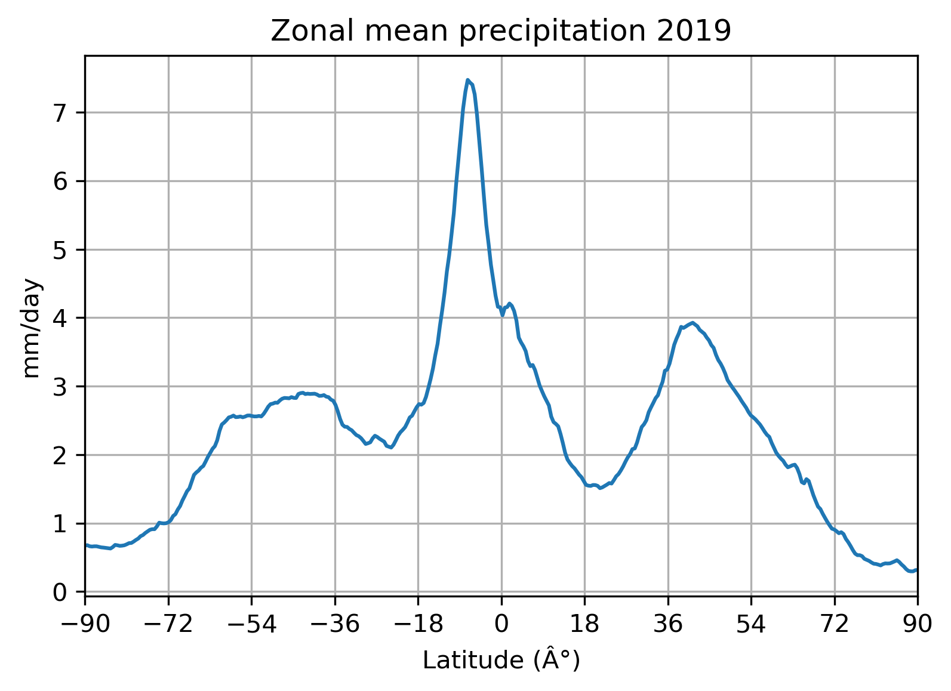
Plot of the precipitation means by latitude

